Slide 1
&
Connected World
Connecting People…Connecting Things…

Slide 2
The network of physical objects—“things”—that are embedded with sensors, software, and other technologies for the purpose of connecting and exchanging data with other devices and systems over the internet is called Internet of Things (IoT).

Slide 3
1990
The concept of connecting objects and items to the Internet is not new.
2000
How people and institutions interact with the Internet in their personal, social, and economic lives is changing
2005
Many Internet of Things devices are designed to operate in the background.
2015
The implications of a world in which the most common interaction with the Internet comes from passive engagement with connected objects,
Evolution Of
IoT
2020
The growth and maturity of the Internet of Things will present both new benefits and new challenges that will require shifts in policy approaches and strategies.
2050
Internet of Things devices will likely touch most aspects of our lives, and are likely to be installed in our homes, workplaces, schools, hospitals, and other public spaces

Slide 4
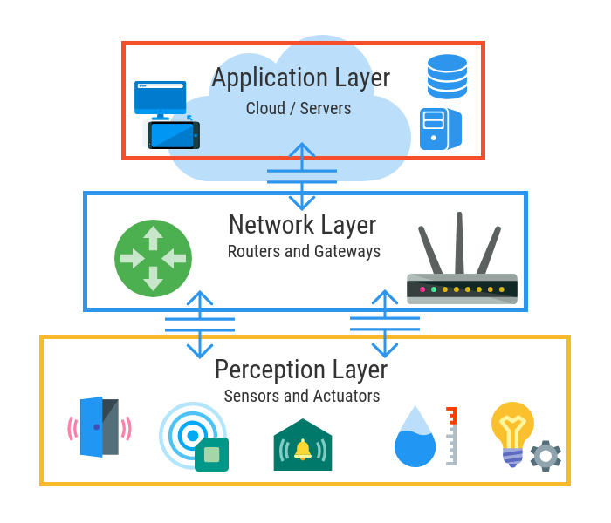
Basic layers of Iot

Slide 5
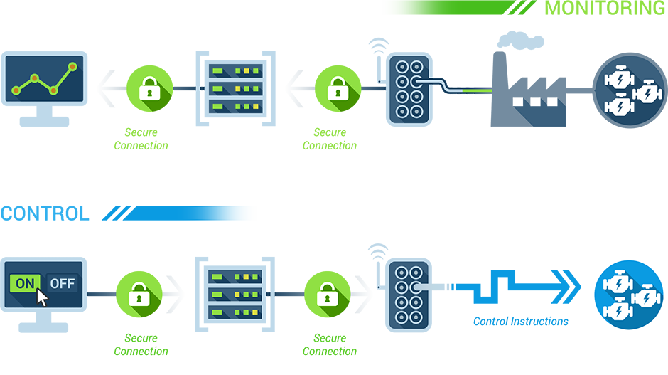
Control & Monitoring

Slide 6
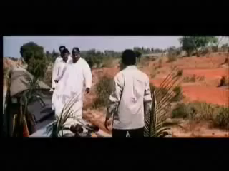
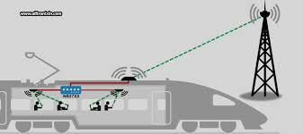
What if????

Slide 7
Applications of Iot
Wearable
Traffic Monitoring
Fleet Management
Agriculture
Health Care

Slide 8
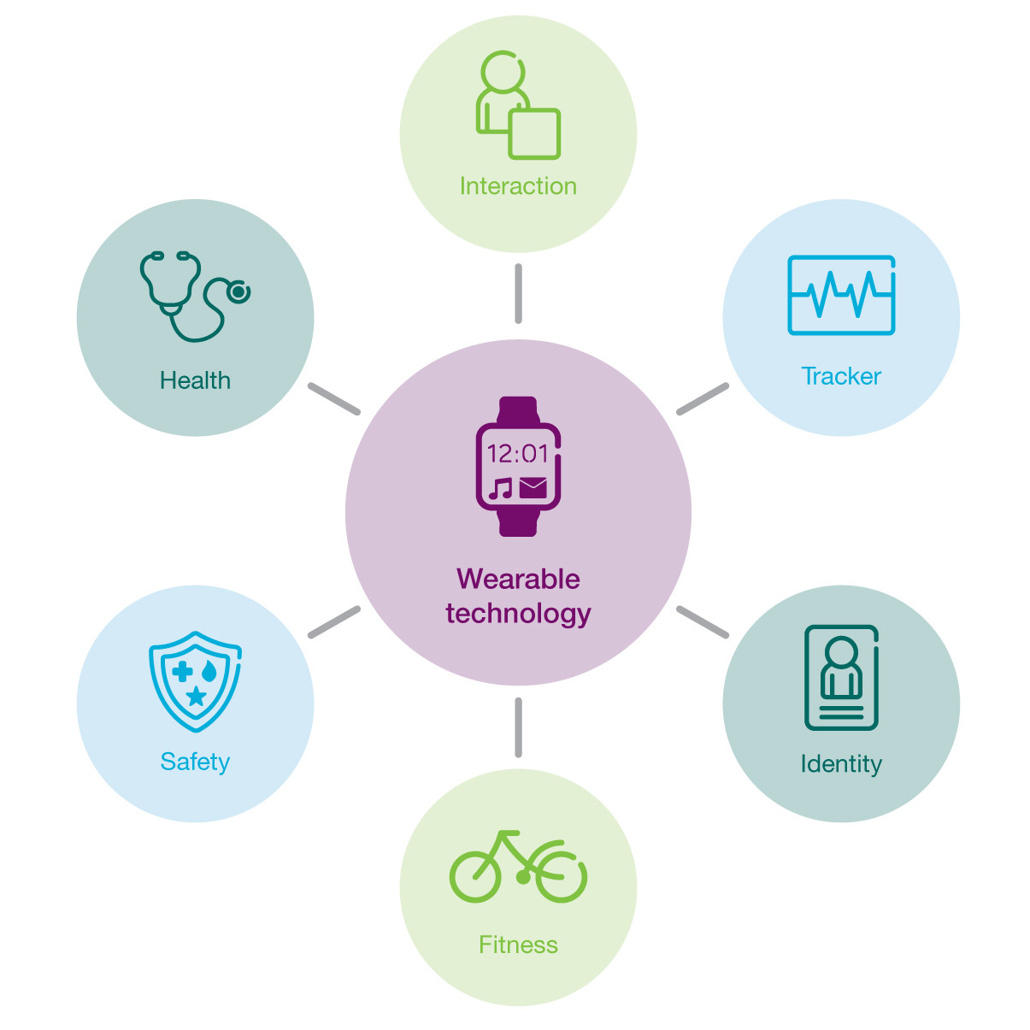
In Wearable’s
Featured snippet from the web
These wearables are becoming an increasingly important part of IoT technology and their development is moving from being simple accessories to more specialized and practical applications.
Smart wearables can interact with an array of other devices, such as smartphones, for the purpose of computing and communication.

Slide 9
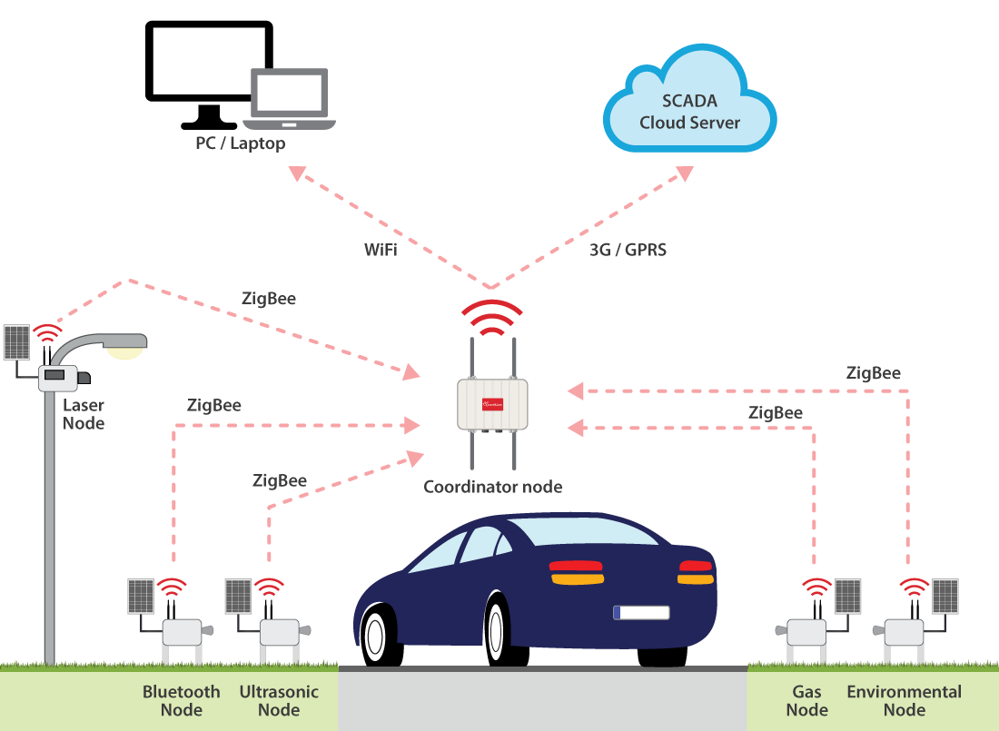
In traffic management
FF car hacking scene
We design and develop system for real-time traffic monitoring using Internet of Things (IoT) platform and sensing technology.
In this system, Ultrasonic sensors are used to detect vehicle traffic levels at the lanes, this data is received at the controller and transmitted to web server through a Wi-Fi module.

Slide 10
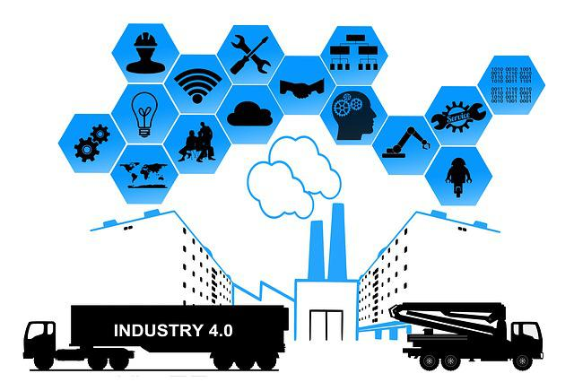
In fleet management
Leveraging the IoT Revolution in Fleet Management
Compliance with environmental and safety regulations.
Optimized maintenance and logistics. Monitor driver performance and vehicle status for better safety and fuel consumption. Scheduled preventative maintenance to improve vehicle valuation

Slide 11
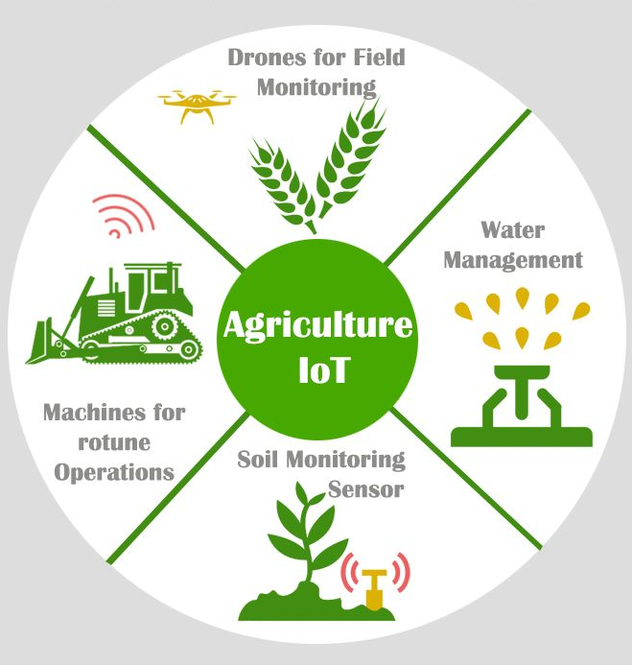
IN AGRICULTURE
In IoT-based smart farming, a system is built for monitoring the crop field with the help of sensors (light, humidity, temperature, soil moisture, etc.)
The farmers can monitor the field conditions from anywhere. IoT-based smart farming is highly efficient when compared with the conventional approach

Slide 12
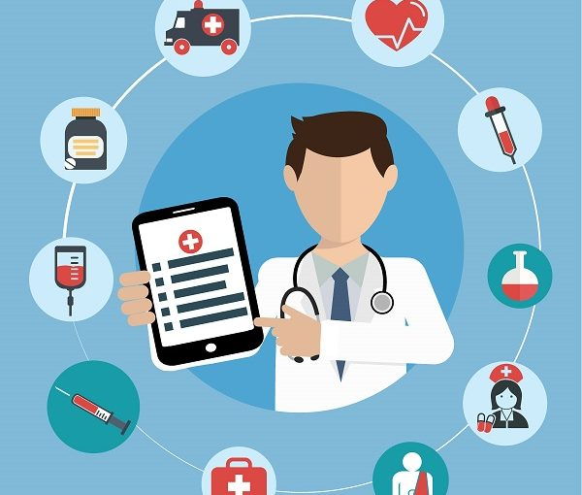
IN HEALTHCARE
IoT has applications in healthcare that benefit patients, families, physicians, hospitals and insurance companies.
They can track patients' adherence to treatment plans or any need for immediate medical attention.
IoT enables healthcare professionals to be more watchful and connect with the patients proactively.

Slide 13
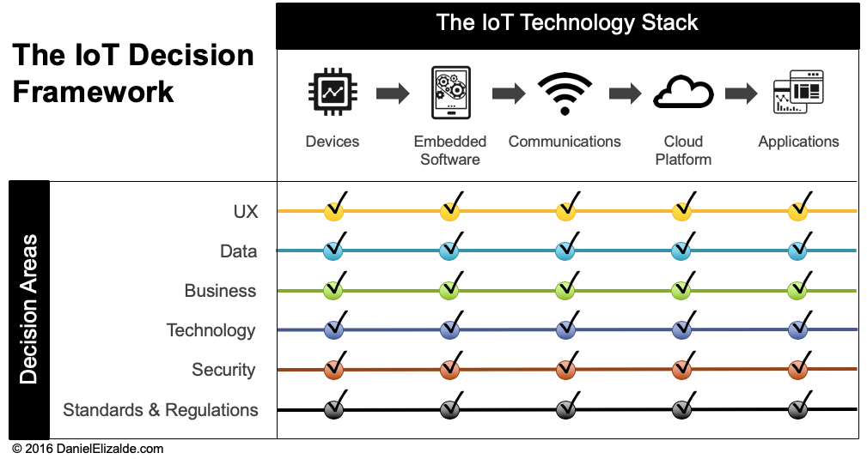
IOT technology stack

Slide 14
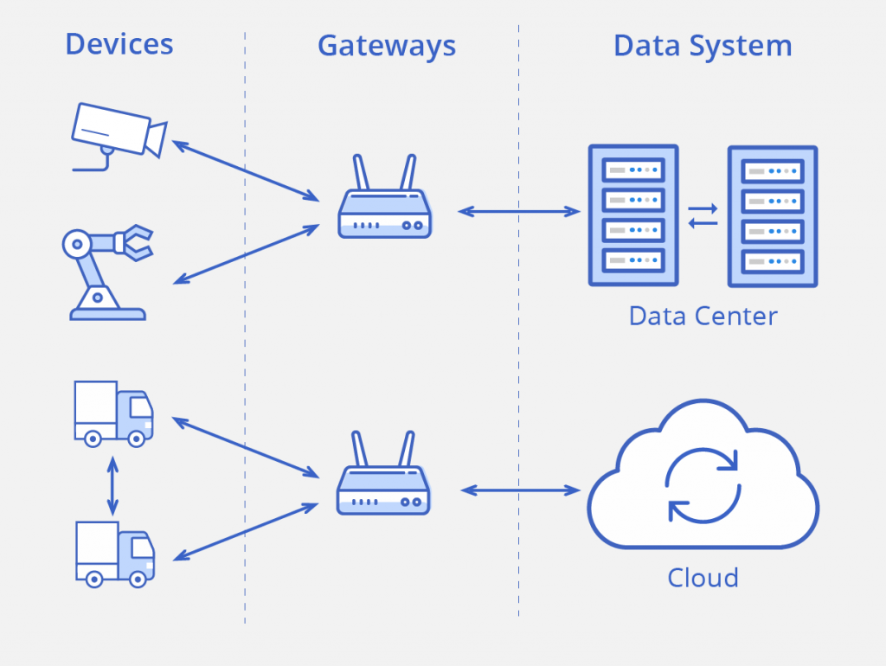
system architecture of iot

Slide 15
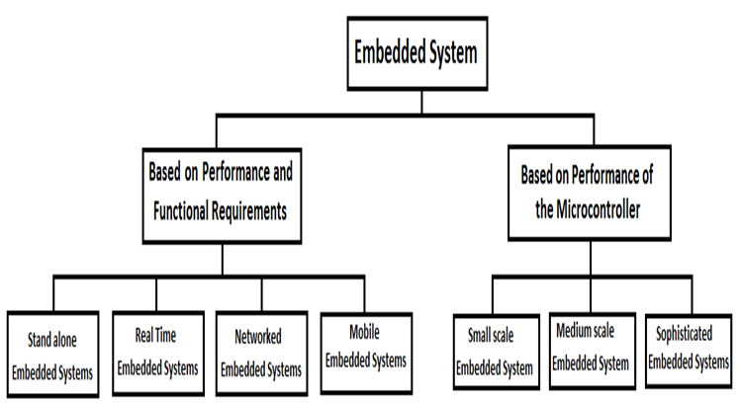
What is embedded system?
An embedded system is a computer system—a combination of a computer processor, computer memory, and input/output peripheral devices—that has a dedicated function within a larger mechanical or electrical system.

Slide 16
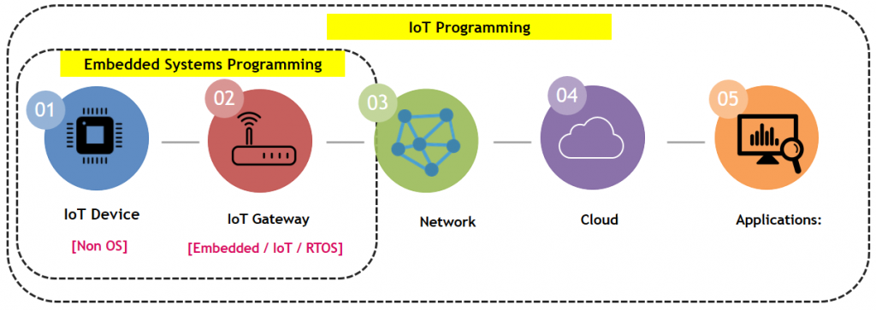
Relation between Iot and embedded systems
IoT is a big model that tries to integrate multiple thing together.
Embedded Systems are part of the overall IoT by taking two key components in terms of IoT devices and IoT gateway.
The IoT devices are smaller and specific in nature which will not have OS running them.

Slide 17
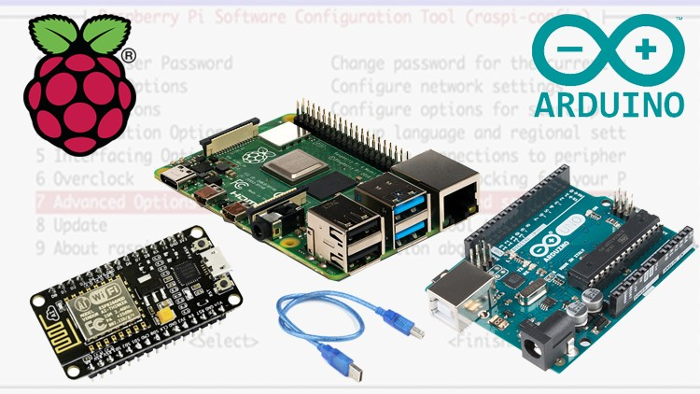
Microcontrollers

Slide 18

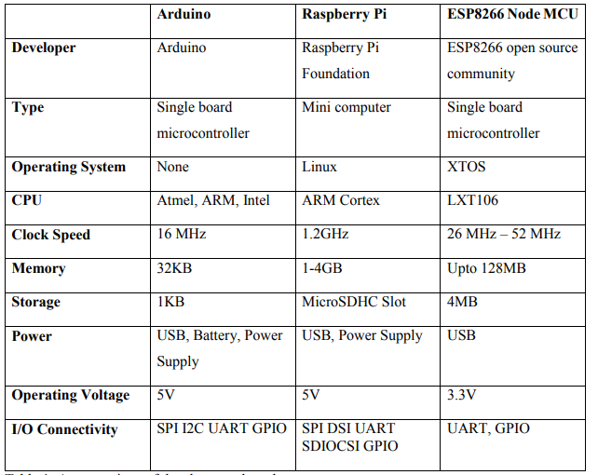



Slide 19
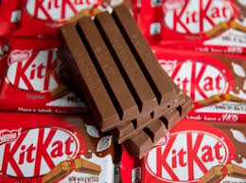

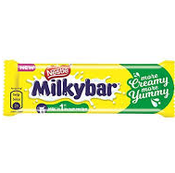
Component | Size | Cost | Pinout | Max Current per I/O pin
Arduino | 43.18 mm x 18.54 mm [1.70 in x 0.73 in] | 300- 600 | 22 pins (14 digital with 6 PWM and 8 Analog) | 40 mA
Raspberry Pi | 65mm x 30mm [2.56 in x 1.18 in] | 2000- 5000 | 40 pins ( 28 of which are GPIO, 12 for power) | 50 mA
ESP8266 Node MCU | 49 mm x 24.5 mm [1.92 in x 0.96 in] | 300- 600 | 16 pins (11 usable digital, 1 Analog) | 12 mA

Slide 20
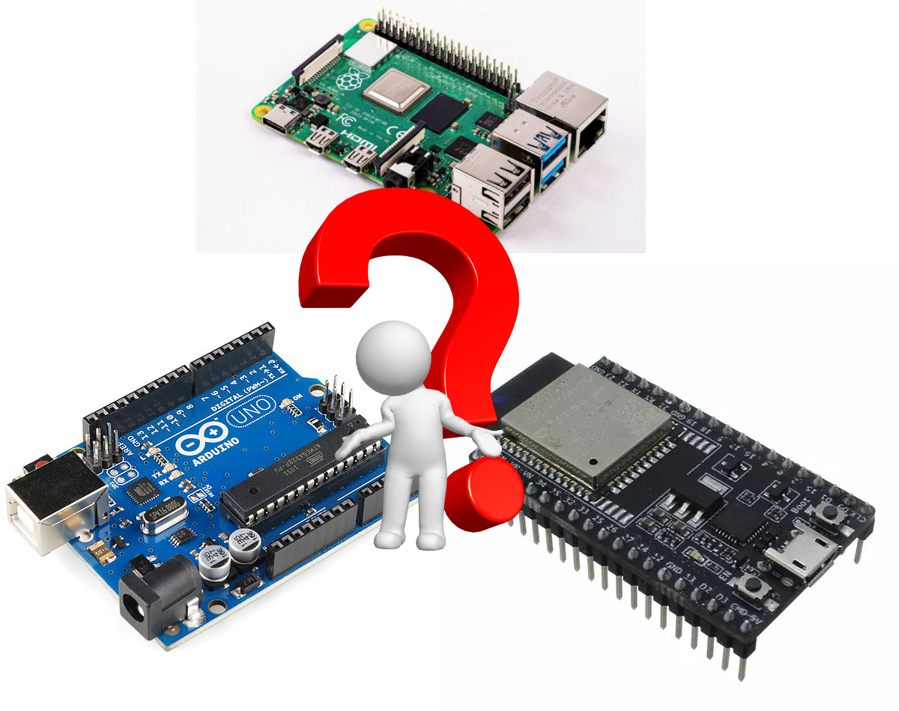
Still confused which one is better?

Slide 21
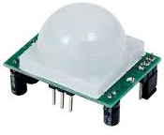
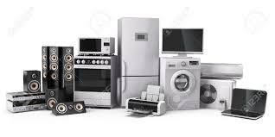
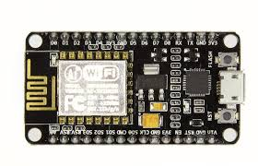
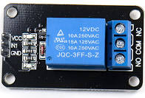

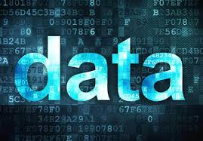


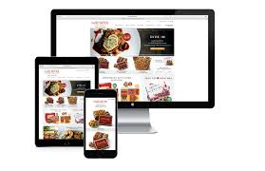
Home Automation

Slide 22
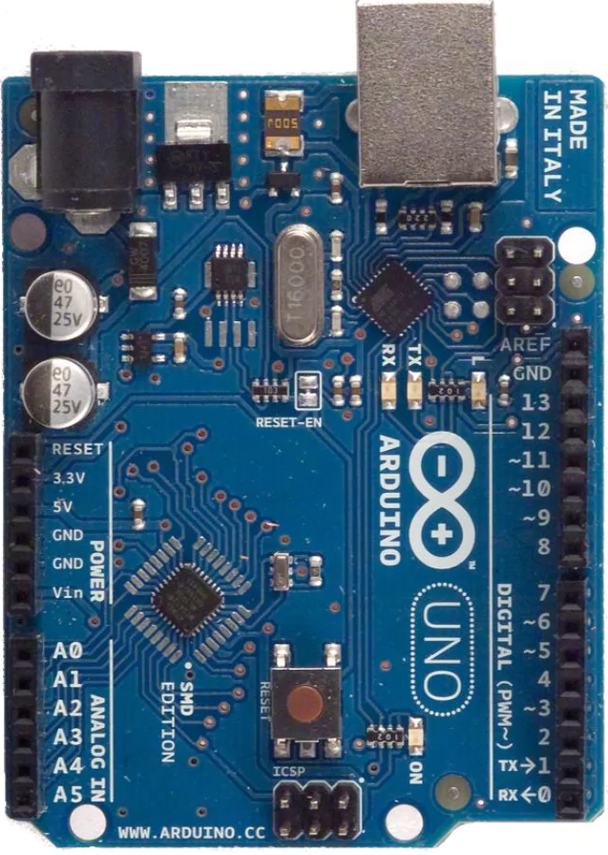
Home automation

Slide 23

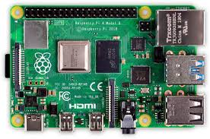
Home automation

Slide 24
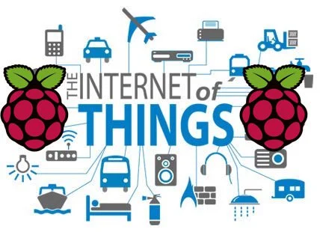
why raspberry pi?
The powerful CPU coupled with Wireless LAN and Bluetooth 4.1 radio makes it an ideal candidate for IoT projects, because multiple sensors can be connected to it simultaneously.
In addition, the Raspberry Pi has a 40-pin GPIO (General Purpose I/O) connector for interfacing with external sensors

Slide 25
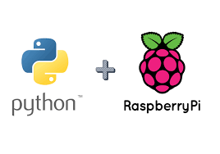
Duo of python and raspberry pi
Python is a wonderful and powerful programming language that's easy to use (easy to read and write) and, with Raspberry Pi, lets you connect your project to the real world.
Python syntax is very clean, with an emphasis on readability, and uses standard English keywords.

Slide 26
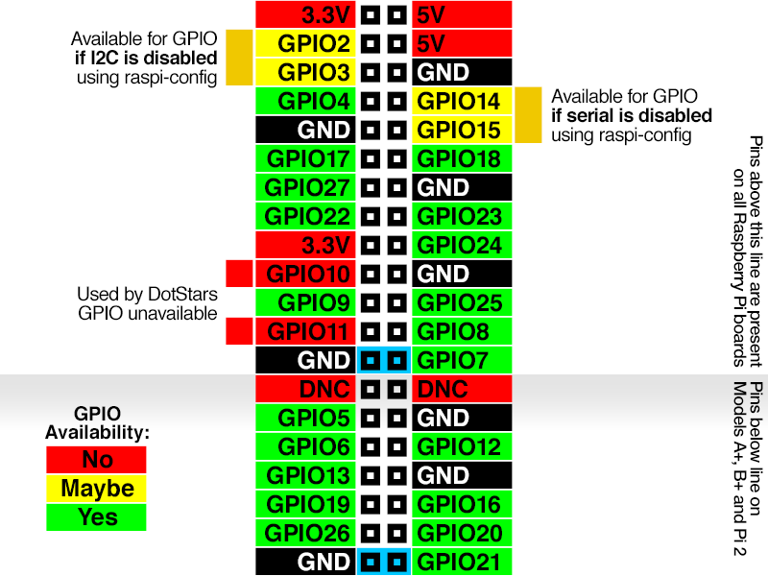
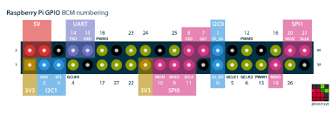
How to Control GPIO Pins on Your Raspberry Pi?
Import the module to talk to the pins.
Set up how you want to refer to the pins.
Initialize the GPIO pins you want to use.
Read or write to the pins.

Slide 27
Virtual Simulations
To create a virtual workspace on Arduino
https://www.tinkercad.com/
To create a virtual workspace on RaspberryPi
https://iotify.io/

Slide 28
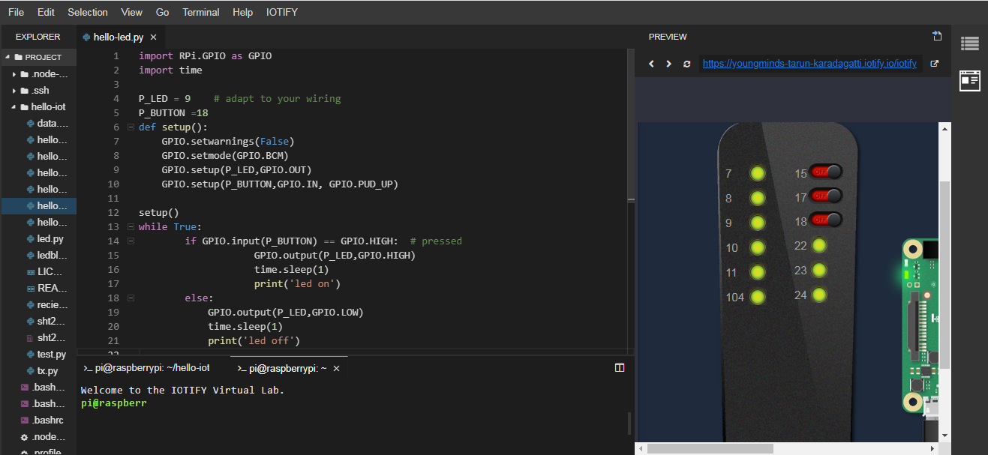
Switch with led

Slide 29
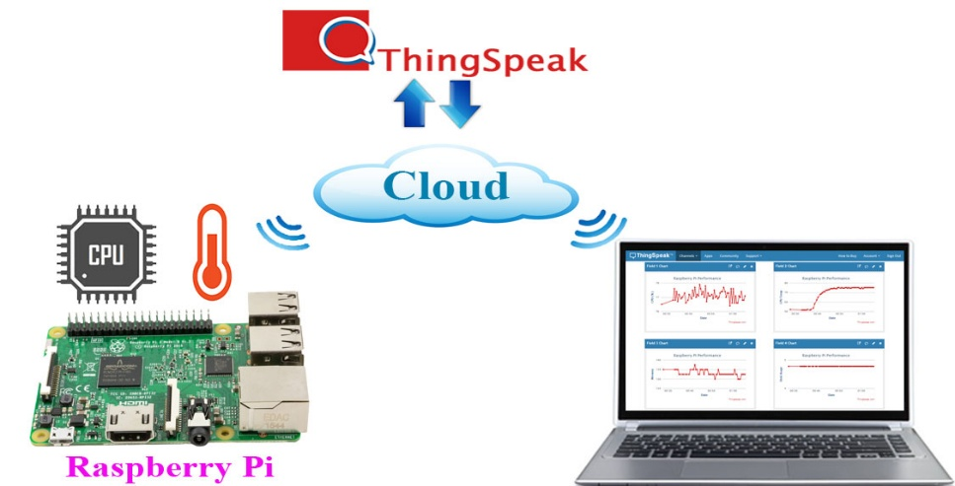
Whether monitoring system using iot
Create thing speak account
www.thingspeak.com
Create new channel
Get API key
Edit the code and then run

Slide 30
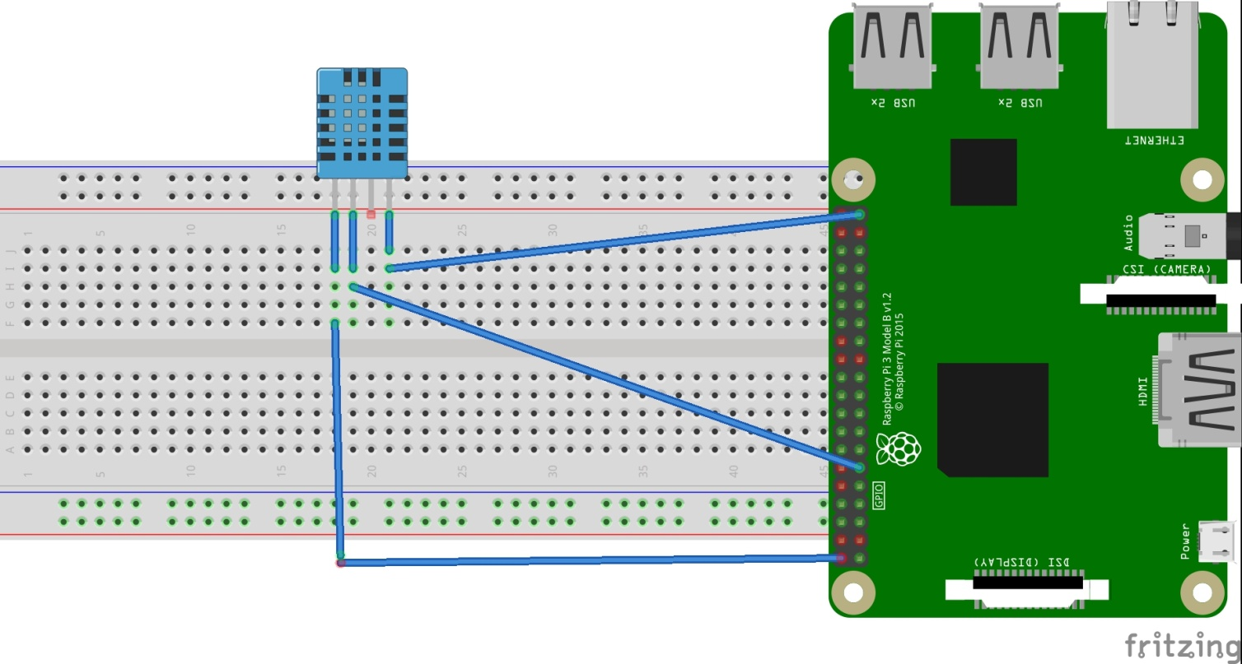
Dht11 interfacing with raspberry pi

Slide 31
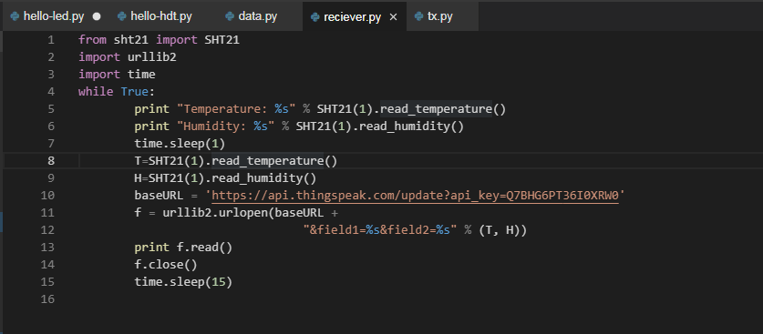
Code for Transmitting data...

Slide 32
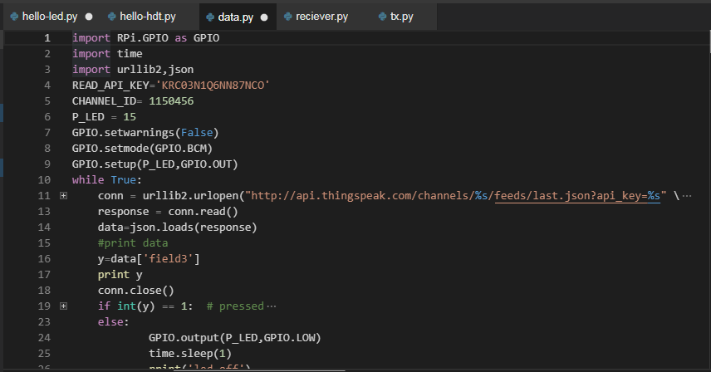
Code for Receiving data...

Slide 33
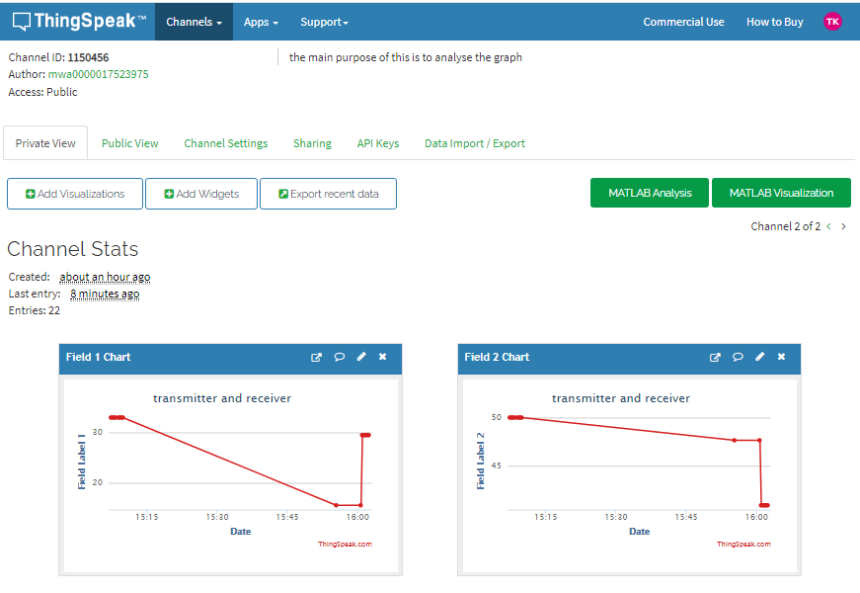
Resultant Output

Slide 34
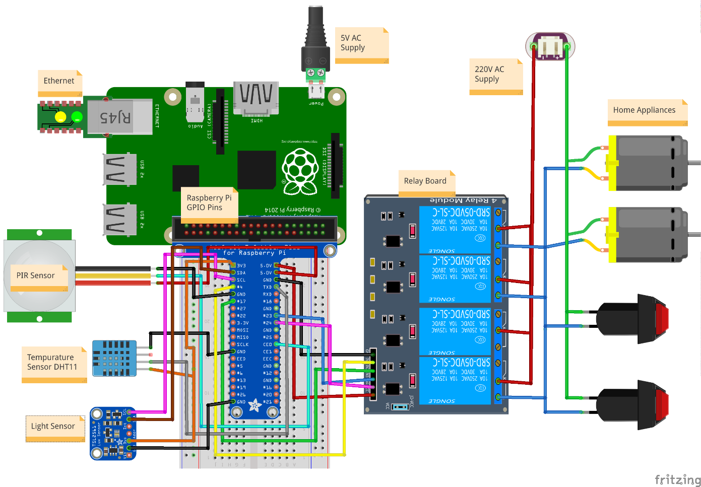
Home automation using raspberry pi

Slide 35
Home automation using raspberry pi
Create Thingspeak account
www.thingspeak.com
Create new channel
Get API key
Edit the code and then run

Slide 36
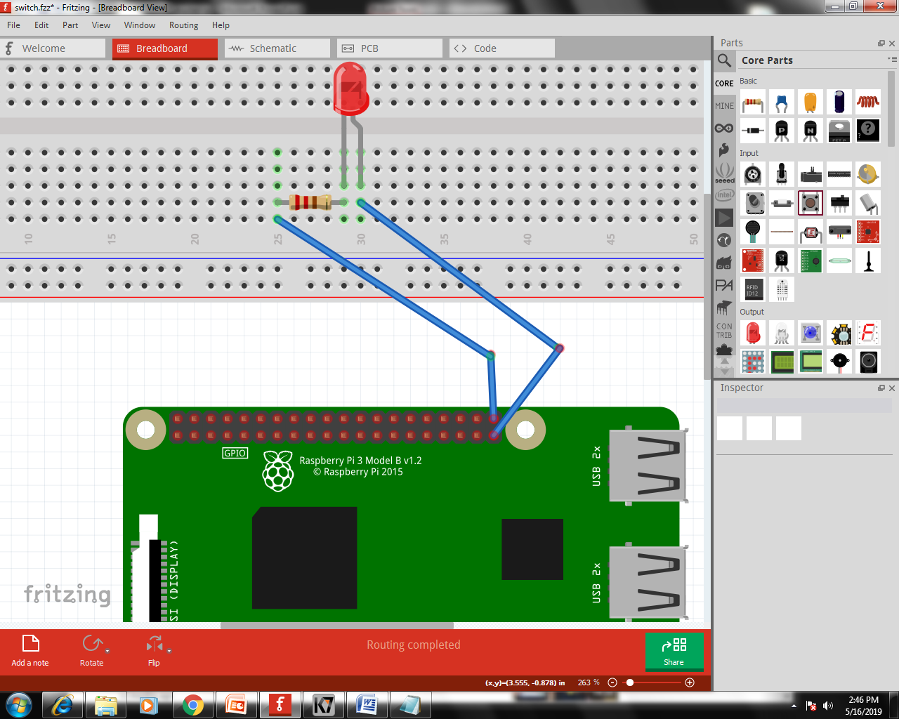
Led interfacing with raspberry pi

Slide 37
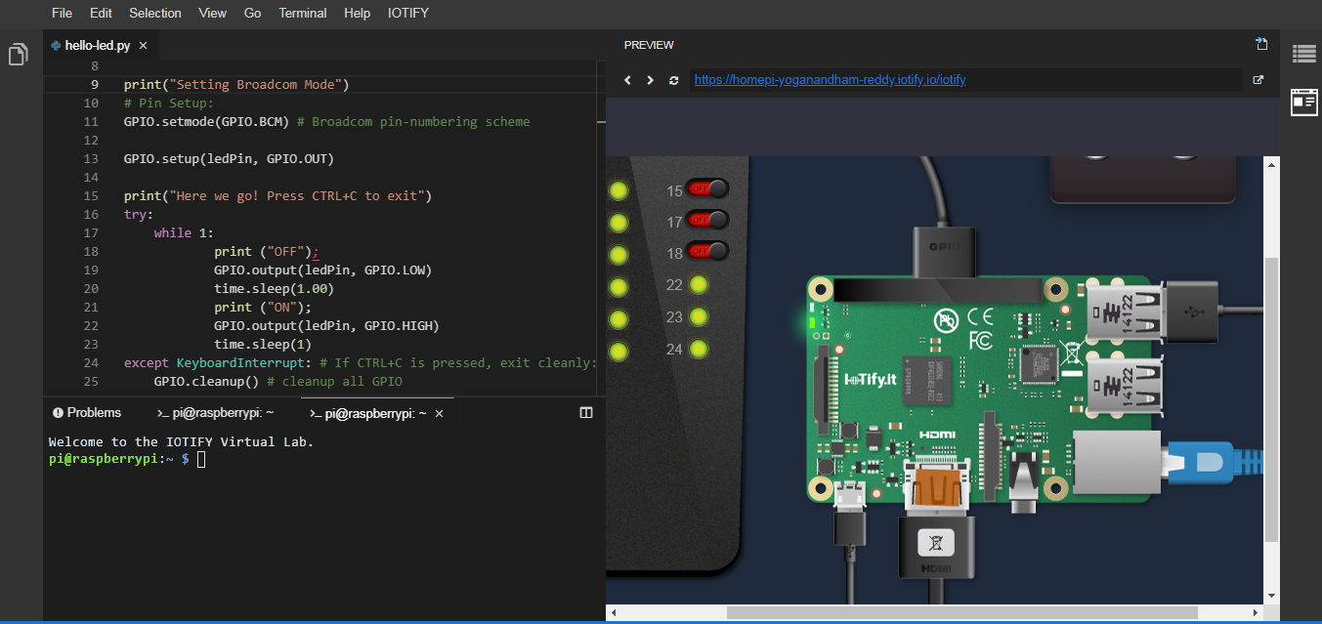
Programming code

Slide 38

TECHNOLOGICAL CHALLENGES OF IoT
Outdated hardware and software. ...
Use of weak and default credentials. ...
Malware and ransom ware. ...
Predicting and preventing attacks. ...
Difficult to find if a device is affected. ...
Data protection and security challenges.

Slide 39
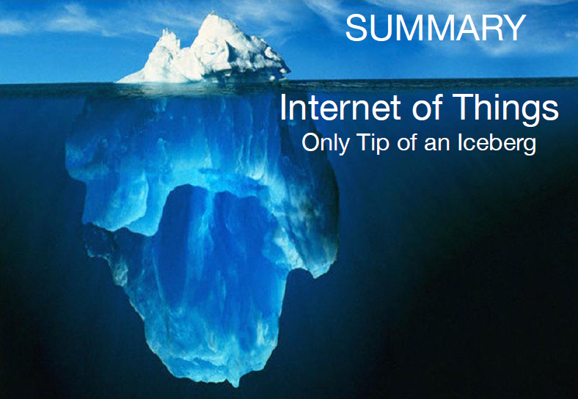
Summary

Slide 40
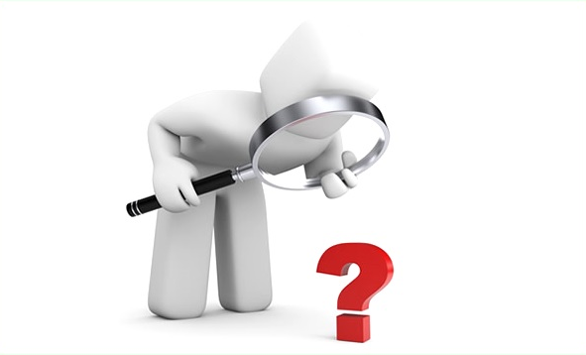
Any queries?
?
?
?

Slide 41
THANK YOU
Insert the Subtitle of Your Presentation

